Slide 1
Literature Review
Dengyu Zhang, Junyu Lu, Riley Heiman

Slide 2
Agenda
Chooser Option
The purpose of this analysis is to study chooser option and their application.
How to price a chooser option?
Closed-form solution
Simulate stock price with jumps
Does the chooser option offer protection from extreme market jumps?
Utilize Natural Language Processing (NLP) to determine market sentiment. This could be an intelligent method to calibrate Jump-Diffusion

Slide 3
Chooser Options
Title: EXOTIC OPTIONS: A CHOOSER OPTION AND ITS PRICING
Authors: Raimonda Martinkutė-Kaulienė
Source:
Business, ManageMent and education
ISSN 2029-7491 print / ISSN 2029-6169 online
2012, 10(2): 289–301 doi:10.3846/bme.2012.20
Publisher: Vilnius Gediminas Technical University
Year: 2012

Slide 4
Chooser Options
Content:
Introduced the characteristics of the chooser option and performed a mathematical method of pricing the chooser options.
Talked about the main factor that will affect the price of the chooser option
Gave an example of how to evaluate the P&L of the chooser option on a single stock.
We can take advantage of the closed form solution of the chooser option that have already been derived by the author and use it in our portfolio risk management from both seller side and buyer side.

Slide 5
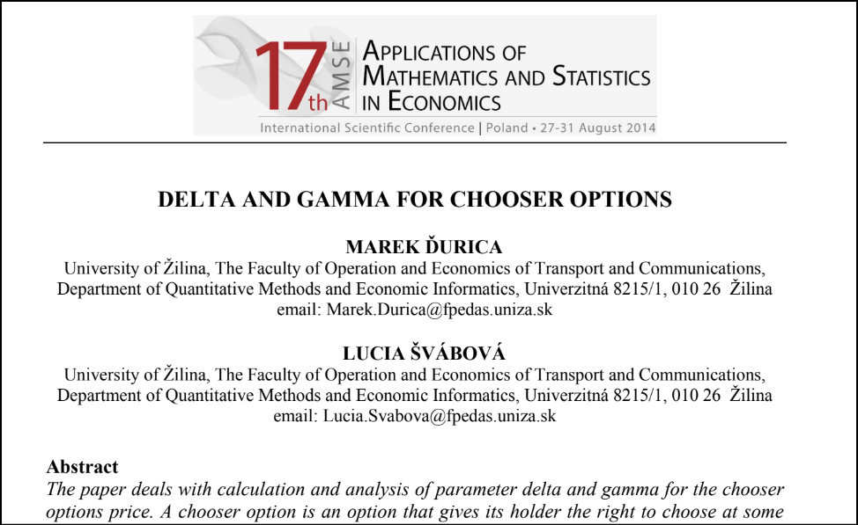
Delta and Gamma for Chooser Options
Title: Delta and Gamma for Chooser Options
Authors: Ďurica M, Švábová L.
Source: AMSE
Publisher: International Scientific Conference Applications of Mathematics and Statistics in Economics
Year: January 2014

Slide 6
Delta and Gamma for Chooser Options
The Key Takeaways from this paper:
Paper defines option greeks for chooser option (Delta & Gamma)
Error of parameter Delta: The difference between the change in the chooser options price with respect to the unit change of the underlying asset price and the value of delta is positively correlated with how close the underlying asset price to the strike price and the choice time.
Delta hedging & Gamma hedging in different situations
– At the money or Out the money
– Static or dynamic hedging
This paper gives us a way to implement hedging strategy (delta neutral & gamma neutral).

Slide 7
Delta and Gamma for Chooser Options
Key Takeaways:
Paper defines option greeks for chooser option (Delta & Gamma)
Delta can be used to dynamically hedge chooser option
Increasing the rebalancing periods (180 days to 1 day) will minimize the risk from the underlying asset
This paper gives us a way to implement hedging strategy (delta neutral & gamma neutral).

Slide 8
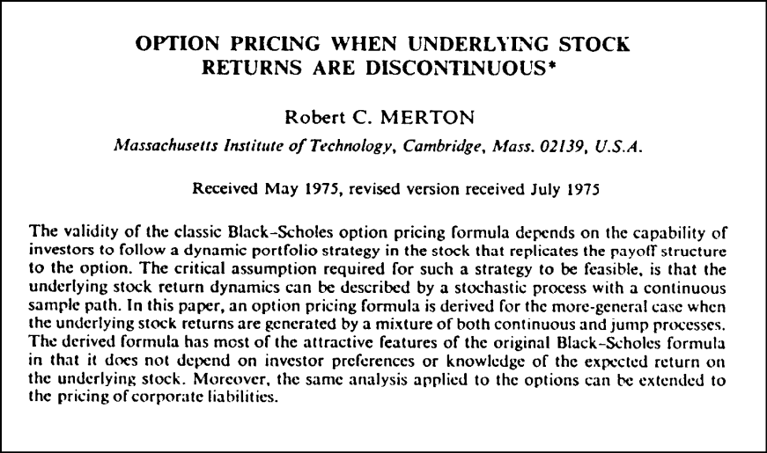
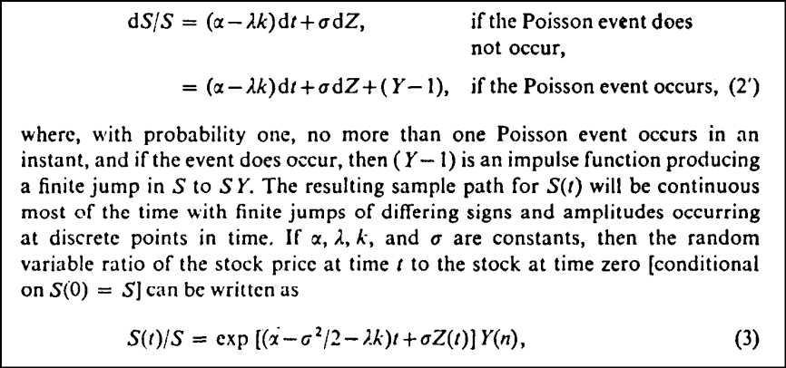
Option Pricing When Underlying Stock Returns are Discontinuous
Title: Option Pricing When Underlying Stock Returns are Discontinuous
Authors: Robert C. Merton
Source: Journal of Financial Economics
Publisher: North-Holland Publishing Company
Year: 1976

Slide 9
Option Pricing When Underlying Stock Returns are Discontinuous
Key takeaways from paper
Challenges an assumption for Black-Scholes (1973)
Proposes an improvement to Geometric Brownian Motion
This includes jump component, which follows Poisson process
Goal is to model the sudden changes in prices due to new information
Later referred to as Merton’s Jump-Diffusion Model

Slide 10
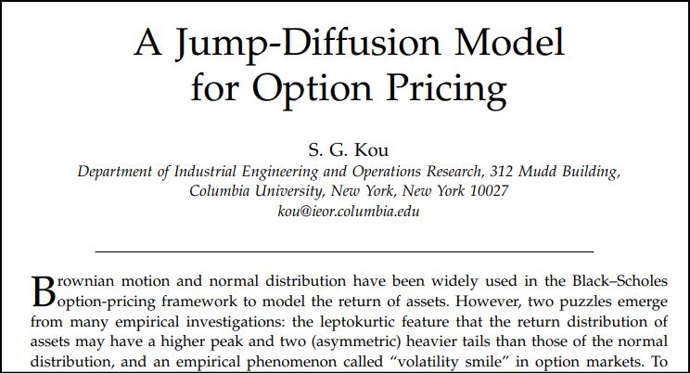
A Jump-Diffusion Model for Option Pricing
Title: A Jump-Diffusion Model for Option Pricing
Authors: Steven G. Kou
Source: Journal of Management Science
Publisher: INFORMS
Year: 2002

Slide 11
A Jump-Diffusion Model for Option Pricing
Key takeaways from paper
Two empirical phenomena challenge the assumptions of Black-Scholes model:
Leptokurtic features (returns exhibit heavy tails & left skewed)
Existence of volatility smile
Paper describes a double exponential jump-diffusion model.
Similar to Merton’s model, expect one variable follows the double exponential distribution
Kou claims this model is easier to derive analytical solutions for path-dependent options

Slide 12
BERT for Stock Market Sentiment Analysis
Title: BERT for Stock Market Sentiment Analysis
Authors: Sousa M G, Sakiyama K, de Souza Rodrigues L
Source: 2019 IEEE 31st International Conference on Tools with Artificial Intelligence (ICTAI)
Publisher: IEEE
Year: 2019

Slide 13
BERT for Stock Market Sentiment Analysis
• The main contribution of the paper
• Compared four popular NLP methods and found the most efficient and easy-to-use models to reduce workload.
• Discussed the accuracy of the target we chosen( industry index or single stock)
• Main methods used in the paper
• BERT model, Support Vector Machines, and Convolutional Neural Network.
• How this paper could help you with your project
• Introduced an advanced NLP model to improve the efficiency and accuracy of our analyze
• Shown the clear steps about how to apply a BERT based model for sentiment analysis

Slide 14
Deep Learning-based Research on Public Opinion Risk
in Diversified Financial Industries
Title: Deep Learning-based Research on Public Opinion Risk in Diversified Financial Industries
Authors: Yushan Du
Source: Dalian University of Foreign Languages
Publisher: CNKI
Year: 2022

Slide 15
Deep Learning-based Research on Public Opinion Risk
in Diversified Financial Industries
• The main contribution of the paper
• Focus on social media comments of stocks
• Implied several BERT models and advanced Bi-LSTM model, then compared the performance
• Constructed useful factors, like Popularity Index, Sentiment Comprehensive score
• Main methods used in the paper
• Bi-LSTM, BERT, RoBERTa, RoFormer
•How this paper could help you with your project
• Gives us more detail about how to build model in many aspects, like factors, model parameters
• Shows different way to measure market sentiment

